Slide 1
Context Free Grammars
Shakir Ullah Shah

Slide 2
Total language tree
For a given CFG, a tree with the start symbol S as its root and whose nodes are working strings of terminals and non-terminals.
The descendants of each node are all possible results of applying every production to the working string. This tree is called total language tree. Following is an example of total language tree

Slide 3
Example
Consider the following CFG
S → aa|bX|aXX
X → ab|b, then the total language tree for the given CFG may be

Slide 4
Example continued …
It may be observed from the previous total language tree that dropping the repeated words, the language generated by the given CFG is
{aa, bab, bb, aabab, aabb, abab, abb}
Notes:
The total language has only seven diffe
rent words. Four of it's words
(abb, aabb, abab, aabab) have two
different possible derivation because
they appear as terminal nodes in this tree in two different places.
<number>

Slide 5

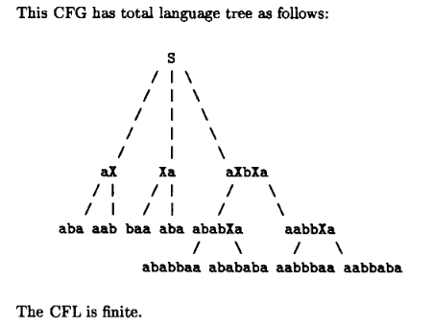
Example 2
<number>

Slide 6
Example
Consider the following CFG
S → X|b , X → aX
then following will be the total language tree of the above CFG

Slide 7
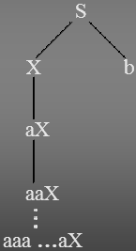
Example
Consider the following CFG
S → X|b , X → aX
then following will be the total language tree of the above CFG

Slide 8
Example
Consider the following CFG
S → X|b , X → aX
then following will be the total language tree of the above CFG
Note: It is to be noted
that the only word in
this language is b.

Slide 9
Semi Word
For a given CFG, semiword is a string of terminals (may be none) concatenated with with exactly one non-terminal (on the right).
In general semiword has the shape
(terminal) (terminal)….(terminal) (Non-Terminal)
e.g. aaaX abcY bbY
A word is a string of terminals only (zero or more terminals)
Λ is also a word.

Slide 10
Regular Grammar
Given an FA, there is a CFG that generates exactly the language accepted by the FA.
In other words, all regular languages are CFLs
CFL
Regular

Slide 11
Creating a CFG from an FA
Step-1 The Non-terminals in CFG will be all names of the states in the FA with the start state renamed S.
Step-2 For every edge
Create productions X→aY or X→aX
Do the same for b-edges
Step-3 For every final-state X, create the production
X→Λ
a
X
a
y
X+

Slide 12
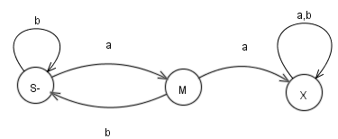
Example
S → aM
S → bS
M → aX
M → bS
X → aX
X → bX
X → Λ
Note: It is not necessary that each CFG
has a corresponding FA. But each FA
has an equivalent CFG.

Slide 13
Theorem
If every production in a CFG is one of the following forms
Nonterminal → semiword
Nonterminal → word
then the language generated by that CFG is regular.
Notes:
<number>

Slide 14
Regular grammar
Definition:
A CFG is said to be a regular grammar if it generates the regular language i.e. a CFG is said to be a regular grammar in which each production is one of the two forms
Nonterminal → semiword
Nonterminal → word
Notes:
<number>

Slide 15
Examples
The CFG S → aaS | bbS | Λ is a regular grammar. It may be observed that the above CFG generates the language of strings expressed by the RE (aa+bb)*.
The CFG S → aA|bB , A → aS|a , B → bS|b is a regular grammar. It may be observed that the above CFG generates the language of strings expressed by RE (aa+bb)⁺.
Following is a method of building TG corresponding to the regular grammar.
Notes:
<number>

Slide 16
TG for Regular Grammar
For every regular grammar there exists a TG corresponding to the regular grammar. Following is the method to build a TG from the given regular grammar.
Define the states, of the required TG, equal in number to that of nonterminals of the given regular grammar. An additional state is also defined to be the final state. The initial state should correspond to the nonterminal S.
For every production of the given regular grammar, there are two possibilities for the transitions of the required TG as follows
Notes:
<number>

Slide 17
Method continued …
(i)
If the production is of the form nonterminal → semiword, then transition of the required TG would start from the state corresponding to the nonterminal on the left side of the production and would end in the state corresponding to the nonterminal on the right side of the production, labeled by string of terminals in semiword.
Notes:
<number>

Slide 18
Method continued …
(ii)
If the production is of the form nonterminal → word, then transition of the TG would start from the state corresponding to nonterminal on the left side of the production and would end on the final state of the TG, labeled by the word. Following is an example in this regard
Notes:
<number>

Slide 19

Example
Consider the following CFG
S → aaS | bbS | Λ
The TG accepting the language generated by the above CFG is given below
The corresponding RE may be (aa+bb)*.
Notes:
<number>

Slide 20
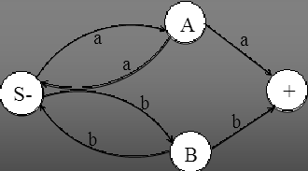
Example
Consider the following CFG
S → aA|bB
A → aS|a
B → bS|b
then the corresponding TG will be
The corresponding RE may be (aa+bb)+
Notes:
<number>

Slide 21
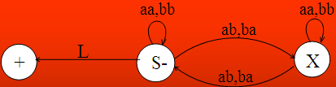
Example
Consider the following CFG
S → aaS | bbS | abX | baX | Λ
X → aaX | bbX | abS | baS
then the corresponding TG will be
The corresponding language is EVEN-EVEN
Notes:
<number>

Slide 22
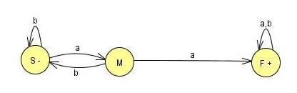
FA Conversion to Regular grammar
Accepts the language of all words with a double a:
S →aM
S →bS
M →aF
M →bS
F →aF
F →bF
F →ʎ
<number>

Slide 23
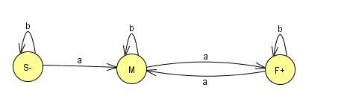
FA Conversion to Regular grammar
Example
The language of all words with an even number of a’s is accepted by the FA:
S → aM I bS
M → bM | aF
F → aF I bF | λ
<number>

Slide 24
Remarks
We have seen that some regular languages can be generated by CFGs, and some non-regular languages can also be generated by CFGs.
ALL regular languages can be generated by CFGs.
There is some non-regular language that cannot be generated by any CFG.
Thus, the set of languages generated by CFGs is properly larger than the set of regular languages, but properly smaller than the set of all possible languages.

